Slide 1

Contactless Debit Cards

Slide 2

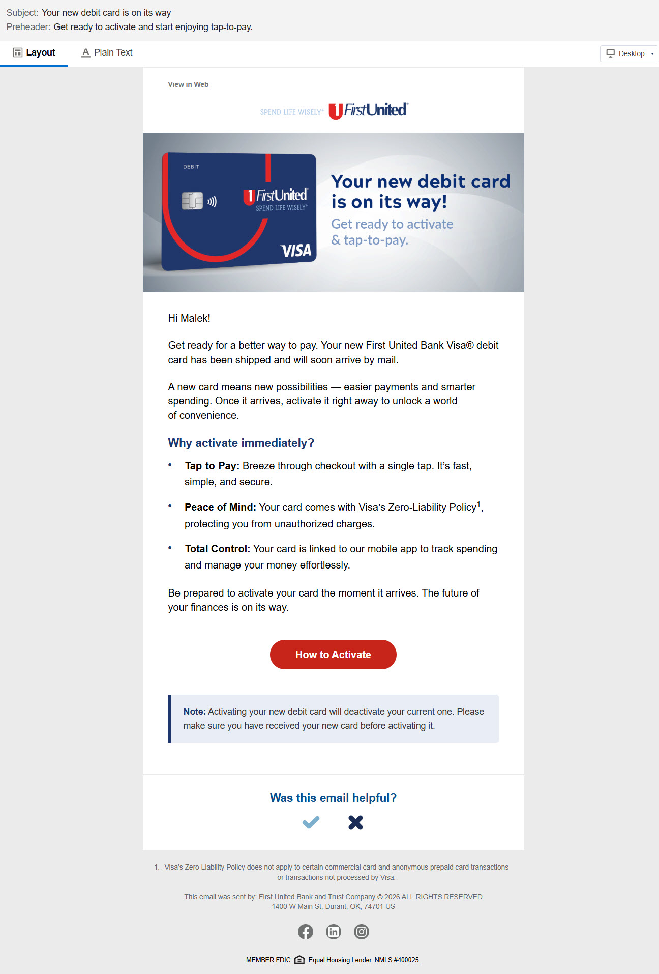
EMAIL 1
Debit card is in transit

Slide 3

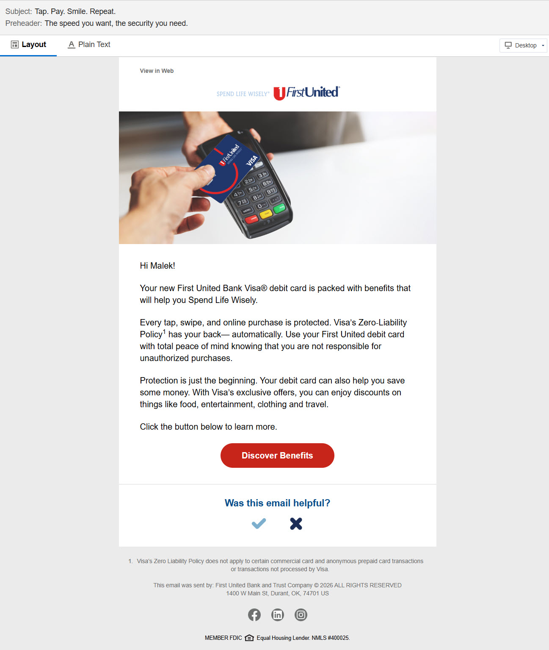
EMAIL 2
Try out Tap-to-Pay

Slide 4

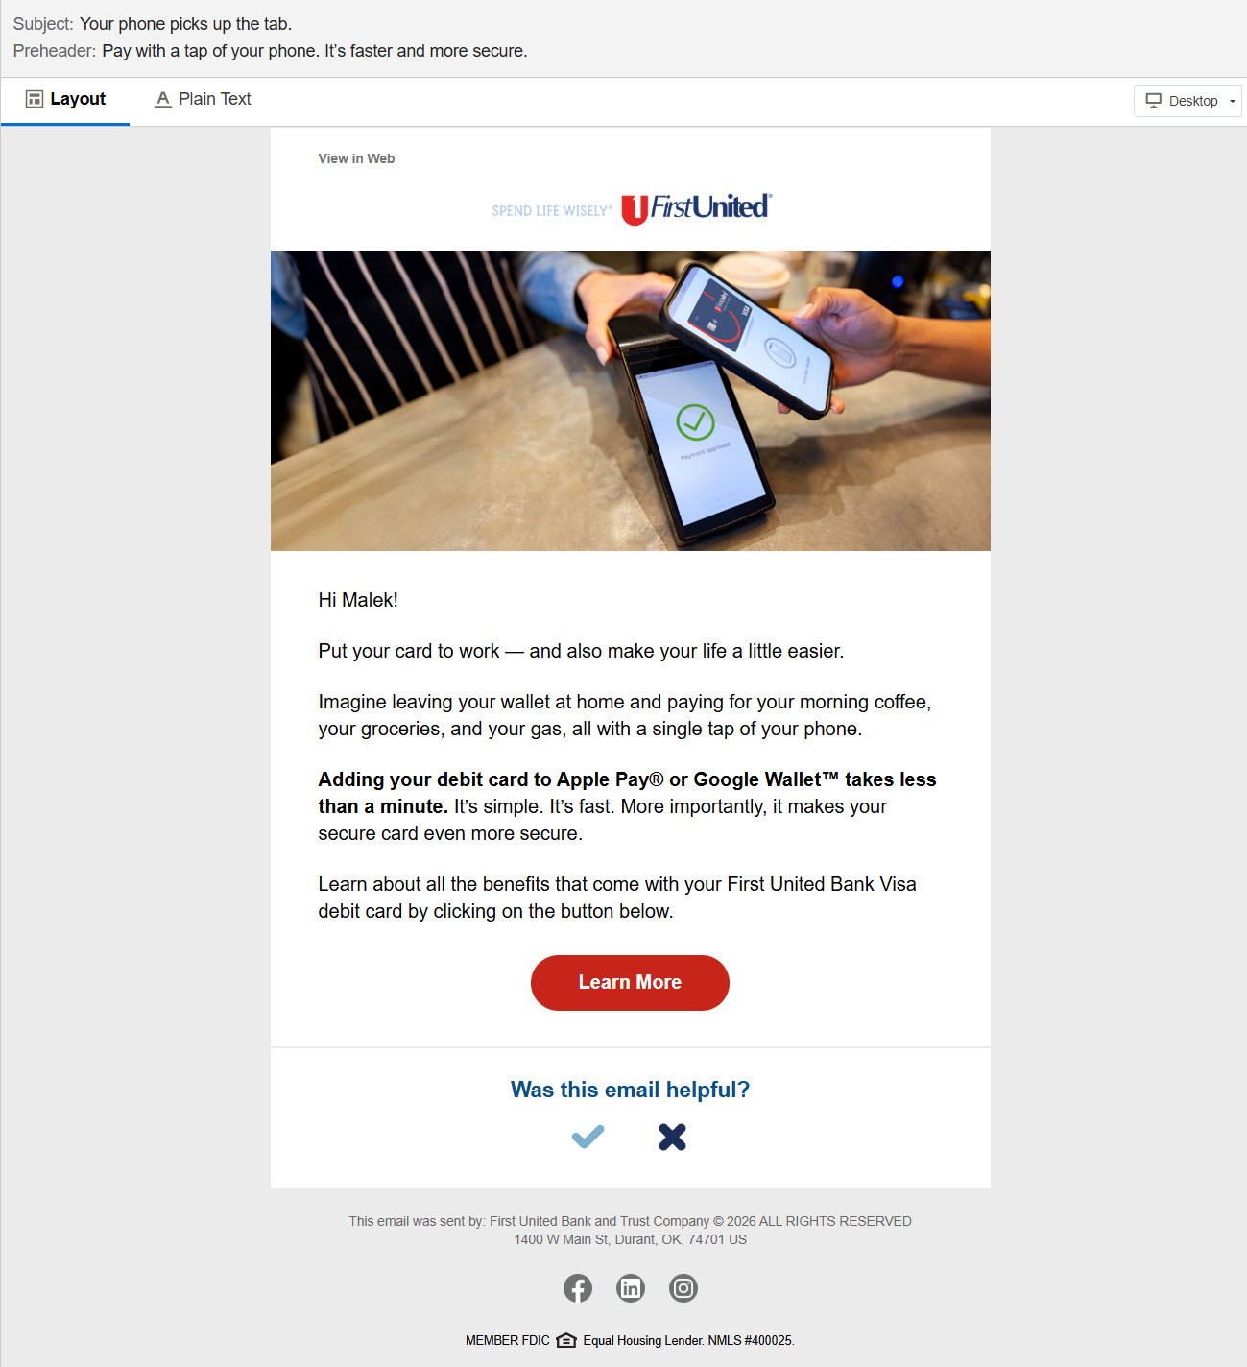
EMAIL 3
Add to a Digital Wallet

Slide 5
SharePoint Folder

